Slide 1
M5

Slide 2
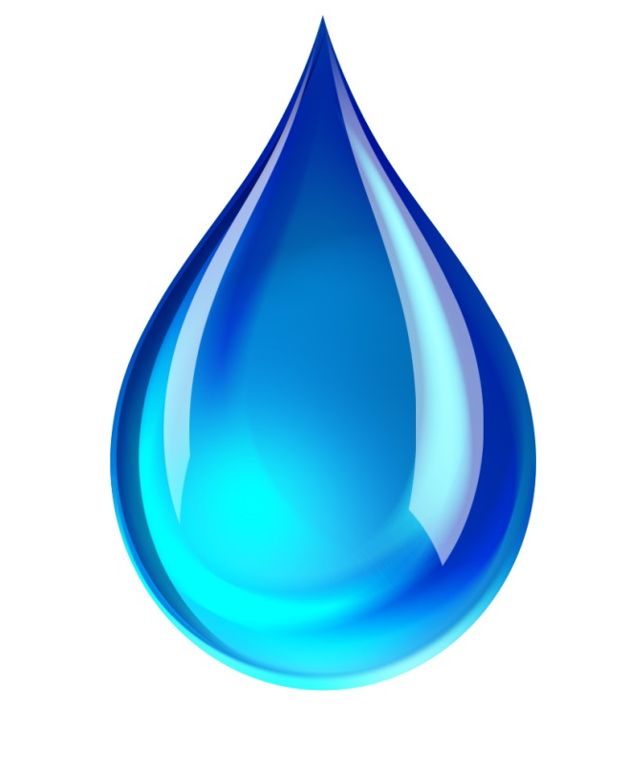

Water: A Wonder Liquid
Water occupies very large area of the Earth’s surface and it also found underground.
Some amount of water exists in the form of water vapour in the atmosphere.
Most of the water found in seas and oceans and is saline
Fresh water is found frozen in ice-caps at the two poles and on snow covered mountains
The underground water and the water in rivers, lakes and ponds is also fresh

Slide 3
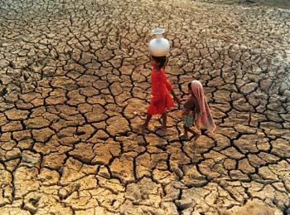
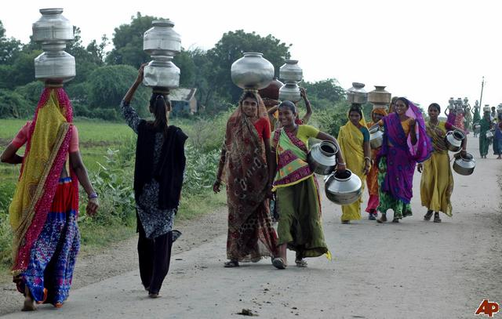
Water: A Wonder Liquid
Practically every summer most places have to face a shortage of water.
And in rural areas, where water supply have not been installed people are forced to spend considerable amounts of time in fetching water from far away sources

Slide 4

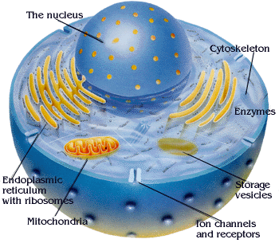

Importance of water
why is water so necessary?
All cellular processes take place in a water medium.

Slide 5
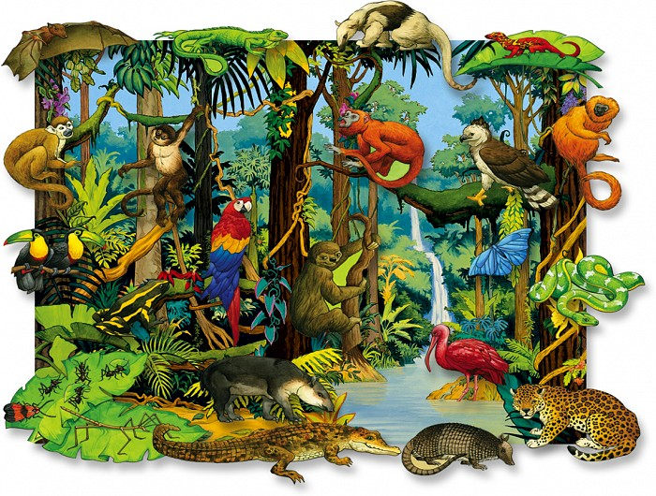
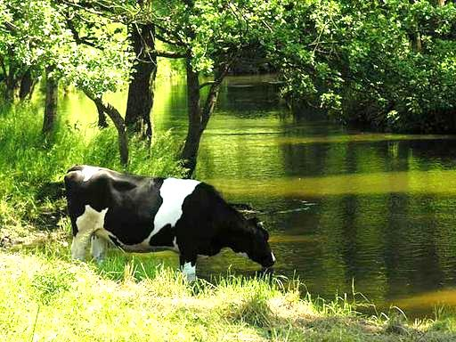
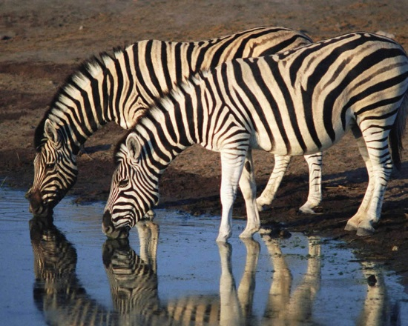
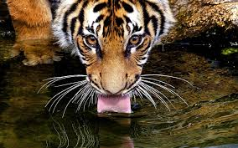
Importance of water
Substances are also transported from one part of the body to the other in a dissolved form
Therefore organisms needs to maintain water level to stay alive
Terrestrial animals require fresh water
Because their bodies cannot tolerate or get rid of high amount of dissolved salts in saline water
Thus, water sources need to be easily accessible for animals and plants to survive on land.
The availability of water decides the number of individuals of each species that are able to survive in a particular area and also the diversity of life there.

Slide 6
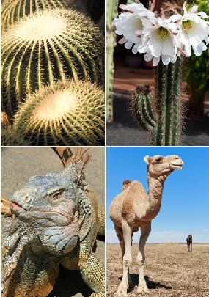
Importance of water
Other factors like temperature and nature of soil also matter.
But water is one of the major resources which determine life on land.

